Slide 1
Course 1: Neural Networks and Deep Learning
Deep Learning Specialization Report
Toshiba Software Development (Vietnam) Co., Ltd.
2021-10-05

Slide 2
Contents
01
Introduction to Deep Learning
02
Logistic Regression as a Neural Network
03
Shallow Neural Network
04
Deep Neural Network

Slide 3
Introduction to Deep Learning
01

Slide 4
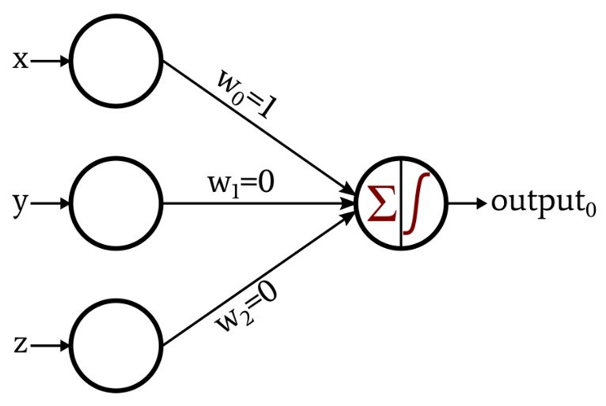
Introduction to Deep Learning
Definition of Neural Network:
A single neuron (perceptron): is a simple model of a biological neuron in an artificial neural network. It is also the name of an early algorithm for supervised learning of binary classifiers.
A Neural Network is comprised of some neuron layers. Each neuron connects to another and has an associated weight and threshold.
A Perceptron Neural Network

Slide 5
Introduction to Deep Learning
Types:
Standard Neural Network
Convolutional Neural Network
Recurrent Neural Network
Hybrid/ Custom Neural Network
Why is deep learning taking off?
Data: the amount of data is increasing,…
Computation: GPU,…
Algorithms: optimization algorithms, activation functions,…

Slide 6
Logistic Regression as a Neural Network
02

Slide 7
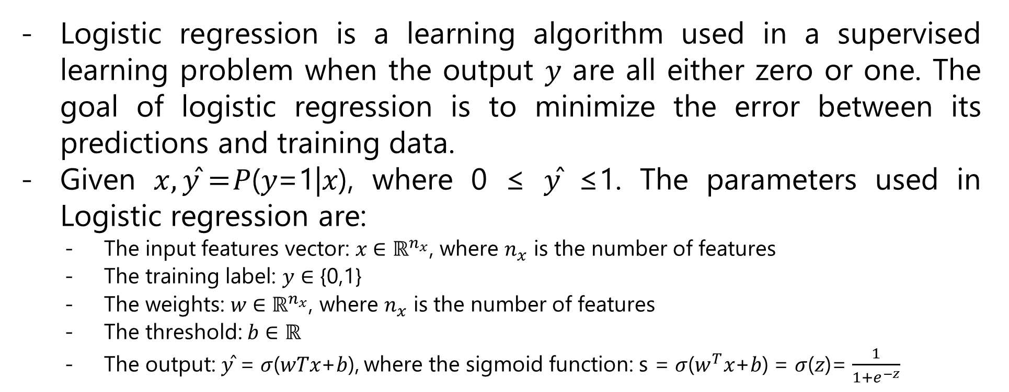
Logistic Regression as a Neural Network
Logistic regression is a learning algorithm used in a supervised learning problem when the output 𝑦 are all either zero or one. The goal of logistic regression is to minimize the error between its predictions and training data.
Given $x,\text{y}\text{̂}=$𝑃(𝑦=1|𝑥), where 0 ≤ 𝑦̂ ≤1. The parameters used in Logistic regression are:
The input features vector: 𝑥 ∈ ${\text{ℝ}}^{n_{x}}$, where $n_{x}$ is the number of features
The training label: 𝑦 ∈ {0,1}
The weights: 𝑤 ∈ ${\text{ℝ}}^{n_{x}}$, where $n_{x}$ is the number of features
The threshold: 𝑏 ∈ ℝ
The output: 𝑦̂ = 𝜎(𝑤𝑇𝑥+𝑏), where the sigmoid function: s = 𝜎($w^{T}$𝑥+𝑏) = 𝜎(𝑧)= $\frac{1}{1+e^{−z}}$

Slide 8
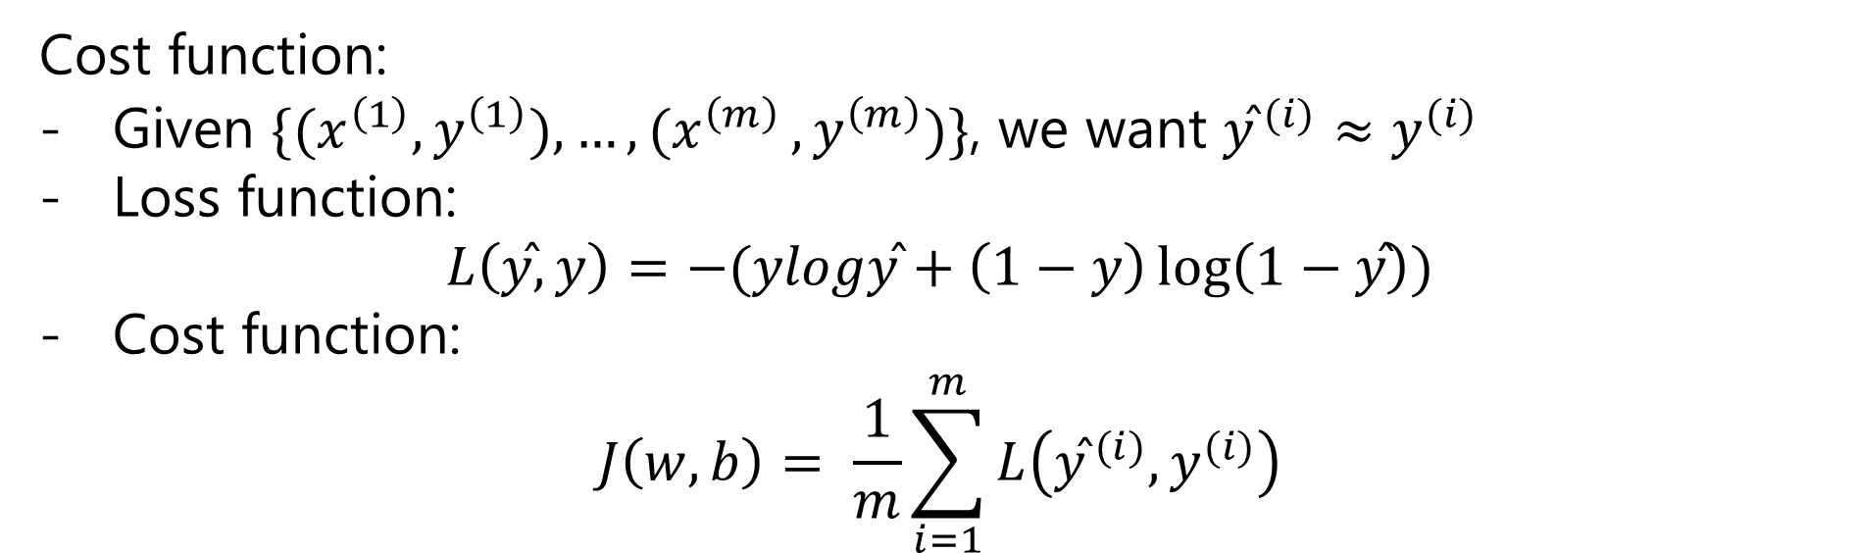
Logistic Regression as a Neural Network
Cost function:
Given $\{{(x}^{\left(1\right)},y^{\left(1\right)}),{…,(x}^{\left(m\right)},y^{\left(m\right)})\}$, we want ${\text{y}\text{̂}}^{ (i)}≈y^{(i)}$
Loss function:
$$L\left(\text{y}\text{̂}, y\right)=−(ylog\text{y}\text{̂}+\left(1−y\right)\log\left(1−\text{y}\text{̂}\right))$$
Cost function:
$$J\left(w, b\right)= \frac{1}{m}\sum_{i=1}^{m}{L\left({\text{y}\text{̂}}^{ (i)},y^{(i)}\right)}$$

Slide 9
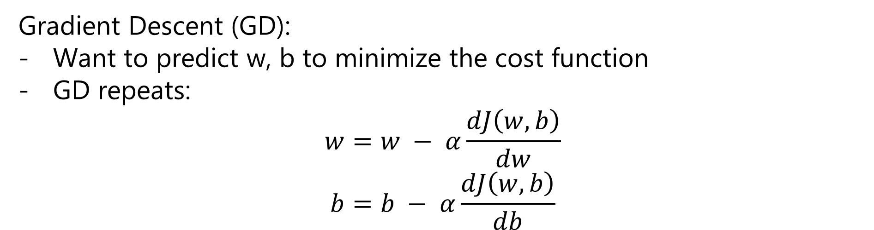
Logistic Regression as a Neural Network
Gradient Descent (GD):
Want to predict w, b to minimize the cost function
GD repeats:
$$w=w − α\frac{dJ\left(w, b\right)}{dw}$$
$$b=b − α\frac{dJ\left(w, b\right)}{db}$$

Slide 10
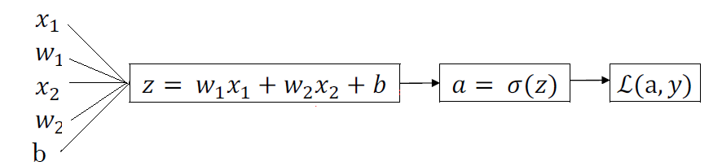

Logistic Regression as a Neural Network
Computation graph for computing derivatives:
$$da= \frac{−y}{a}+\frac{1−y}{1−a}$$
$$dz=a\left(1−a\right)$$
$$dw_{1}=x_{1}dz$$
$$dw_{2}=x_{2}dz$$
$$db=dz$$

Slide 11
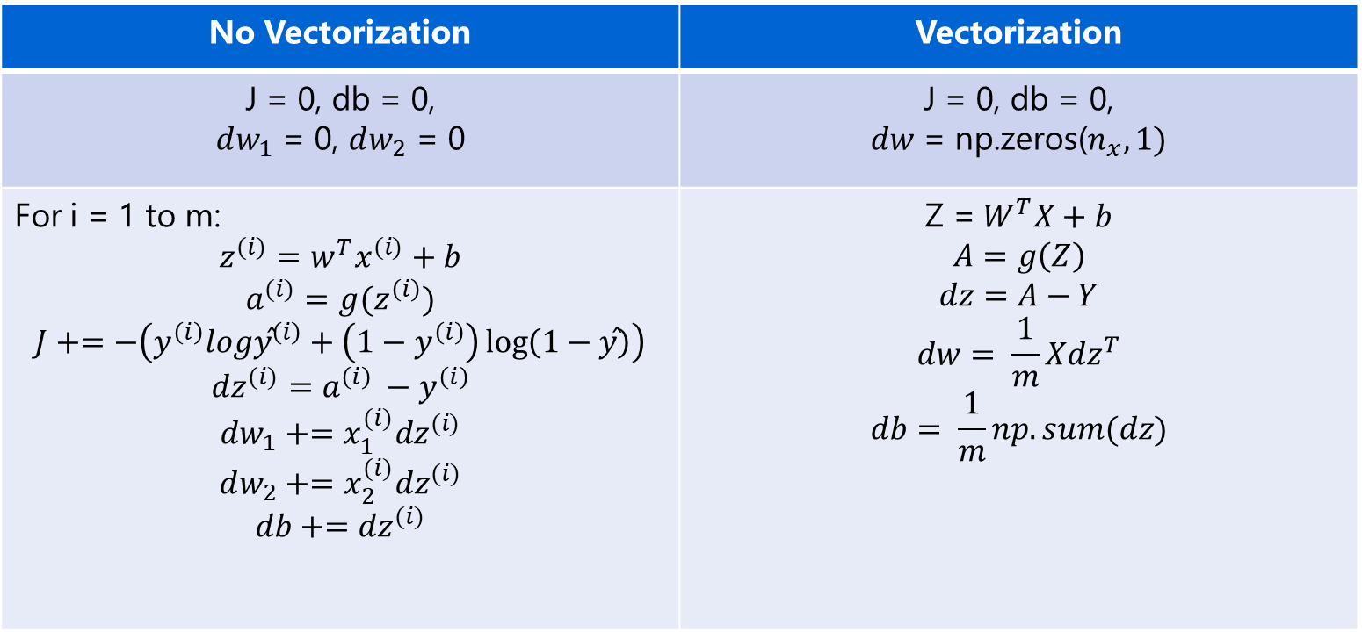
Logistic Regression as a Neural Network
Gradient Descent for m examples:
No Vectorization | Vectorization
J = 0, db = 0, $dw_{1}$ = 0, $dw_{2}$ = 0 | J = 0, db = 0, $dw$ = np.zeros($n_{x}, 1)$
For i = 1 to m: $$z^{(i)}=w^{T}x^{(i)}+b$$ $$a^{(i)}=g(z^{\left(i\right)})$$ $$J+=−\left(y^{\left(i\right)}log{\text{y}\text{̂}}^{\left(i\right)}+\left(1−y^{\left(i\right)}\right)\log\left(1−\text{y}\text{̂}\right)\right)$$ $${dz}^{(i)}=a^{\left(i\right)} −y^{\left(i\right)}$$ $$dw_{1}+={x_{1}^{(i)}dz}^{(i)}$$ $$dw_{2}+={x_{2}^{(i)}dz}^{(i)}$$ $$db+={dz}^{(i)}$$ | $$\text{Z}\text{ =} W^{T}X+b$$ $$A=g\left(Z\right)$$ $$dz=A−Y$$ $$dw= \frac{1}{m}X{dz}^{T}$$ $$db= \frac{1}{m}np.sum(dz)$$

Slide 12
Shallow Neural Network
03

Slide 13
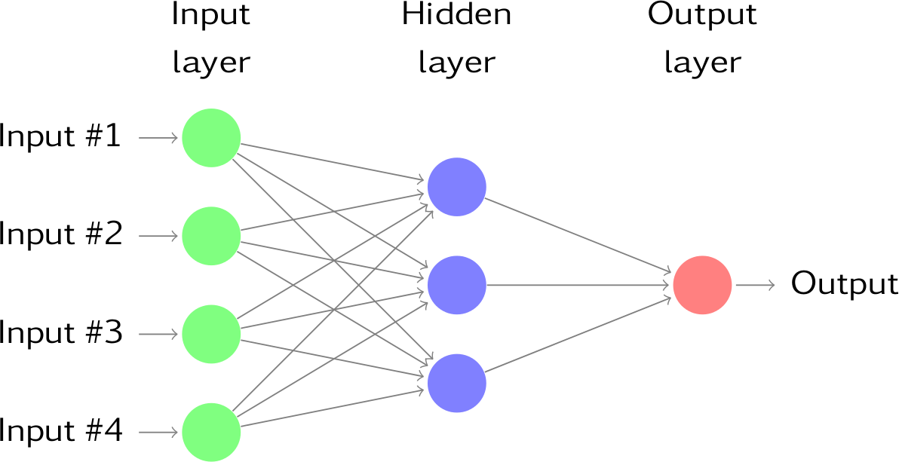
Shallow Neural Network
2-layer Neural Network

Slide 14
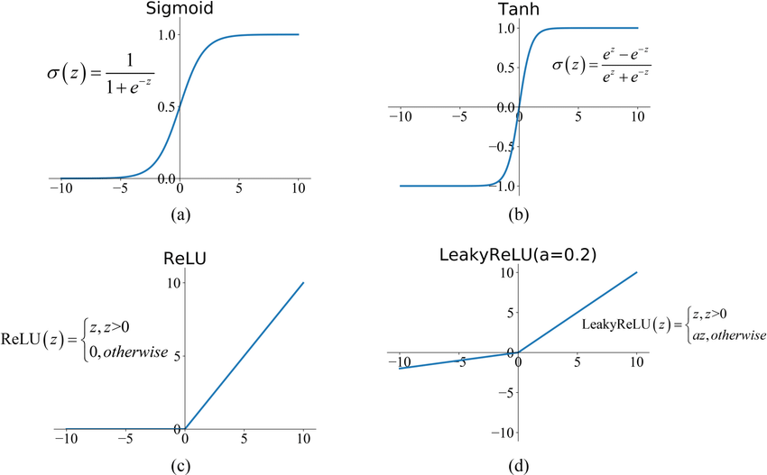
Shallow Neural Network
Activation function:

Slide 15
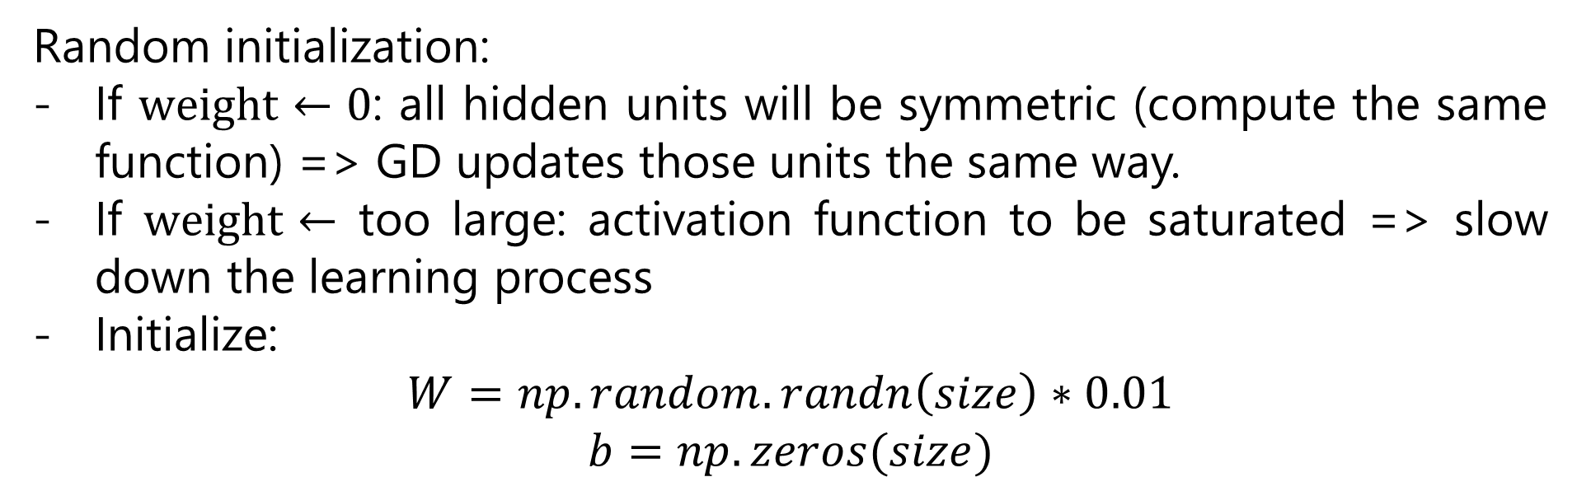
Shallow Neural Network
Random initialization:
If $weight←0$: all hidden units will be symmetric (compute the same function) => GD updates those units the same way.
If $weight←$ too large: activation function to be saturated => slow down the learning process
Initialize:
$$W=np.random.randn\left(size\right)∗0.01$$
$$b=np.zeros(size)$$

Slide 16
Deep Neural Network
04

Slide 17
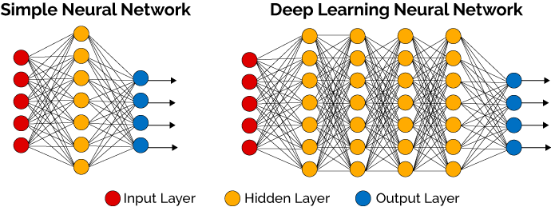
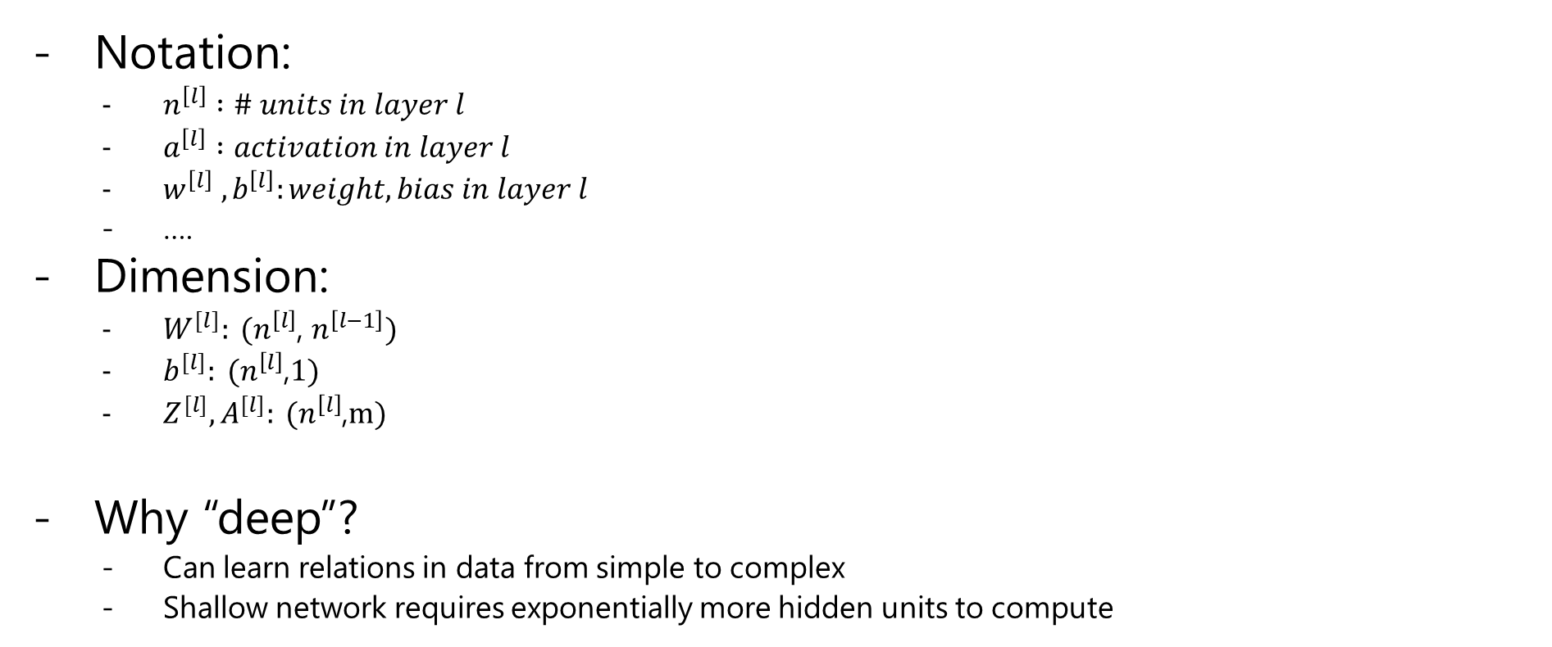
Deep Neural Network
Notation:
$n^{\left[l\right]} :\# units in layer l$
$a^{\left[l\right]} :activation in layer l$
$w^{\left[l\right]} ,b^{\left[l\right]}:weight, bias in layer l$
….
Dimension:
$W^{[l]}: (n^{\left[l\right]}$, $n^{\left[l−1\right]})$
$b^{[l]}: (n^{\left[l\right]}$,$1)$
$Z^{[l]}, A^{[l]}: (n^{\left[l\right]}$,$m)$
Why “deep”?
Can learn relations in data from simple to complex
Shallow network requires exponentially more hidden units to compute

Slide 18
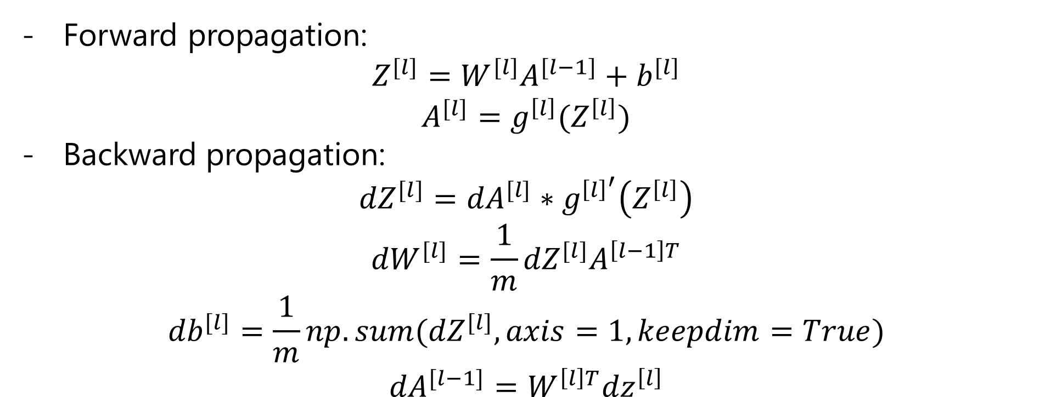
Deep Neural Network
Forward propagation:
$$Z^{[l]}=W^{[l]}A^{[l−1]}+b^{[l]}$$
$$A^{[l]}=g^{\left[l\right]}(Z^{\left[l\right]})$$
Backward propagation:
$${dZ}^{[l]}={dA}^{[l]}∗g^{{\left[l\right]}^{′}}\left(Z^{\left[l\right]}\right)$$
$${dW}^{[l]}=\frac{1}{m}{dZ}^{[l]}A^{\left[l−1\right]T}$$
$${db}^{[l]}=\frac{1}{m}{np.sum(dZ}^{[l]}, axis=1, keepdim=True)$$
$${dA}^{[l−1]}=W^{\left[l\right]T}{dz}^{\left[l\right]}$$

Slide 19
Thank you

